Slide 1
South Dakota American legion
Cyber Security
Scam warfare

Slide 2
Security Awareness
Think of a company as a family. Everyone in the family is responsible. Teach your family members how to be watchful.
Notes:
Think of a company as a family. Everyone in the family is responsible. Teach your family members how to be watchful. Think security while speaking publicly, or communicating via the phone, electronically, or the US Mail.

Slide 3
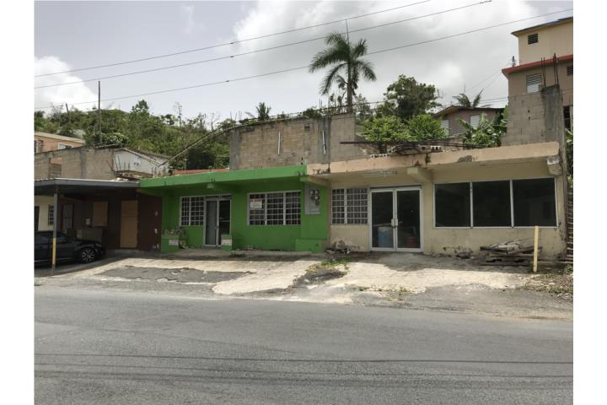
Notes:
Internet fraud is big business in countries such as Nigeria. What might be going on in this Nigerian building?

Slide 4
Identity Theft
Notes:
What is identity theft? The fraudulent acquisition and use of a person's private identifying information, usually for financial gain. Identity theft happens to one out of four individuals.

Slide 5
Watch out for Phishing emails!
What is phishing? The fraudulent practice of sending emails purporting to be from reputable companies in order to induce individuals to reveal personal information, such as passwords and credit card numbers.
Notes:
What is phishing? The fraudulent practice of sending emails purporting to be from reputable companies in order to induce individuals to reveal personal information, such as passwords and credit card numbers.

Slide 6
Malicious Email
Malicious email is phishing for personal information with malicious links or attachments. And unlike spam, malicious email content seems urgent, trying to get users to click on or open something. Attackers write emails that sound urgent and appealing to get users to click a URL or open an attachment.
Notes:
Malicious email is phishing for personal information with malicious links or attachments. And unlike spam, malicious email content seems urgent, trying to get users to click on or open something. Attackers write emails that sound urgent and appealing to get users to click a URL or open an attachment.

Slide 7
Malware can ruin your day!
What is malware? Software that is specifically designed to disrupt, damage, or gain unauthorized access to a computer system.
Notes:
What is malware? Software that is specifically designed to disrupt, damage, or gain unauthorized access to a computer system.

Slide 8
Social Engineering
What is social engineering? The use of deception to manipulate individuals into divulging confidential or personal information that may be used for fraudulent purposes.
Notes:
What is social engineering? The use of deception to manipulate individuals into divulging confidential or personal information that may be used for fraudulent purposes.

Slide 9
Ransomware?
What is ransomware? A type of malicious software designed to block access to a computer system until a sum of money is paid.
Notes:
Ransomware has become a popular tactic for cyber criminals to lock users out of their computers or other devices and extract huge sums of money from the victims. Seriously -- suspicious ransomware transactions averaged roughly $2.2 million per day in 2021. Because of this, everyone must have the knowledge they need to safeguard sensitive information in the face of these and other cyber attacks.

Slide 10
Passwords
Notes:
Next slide discusses secure passwords.

Slide 11
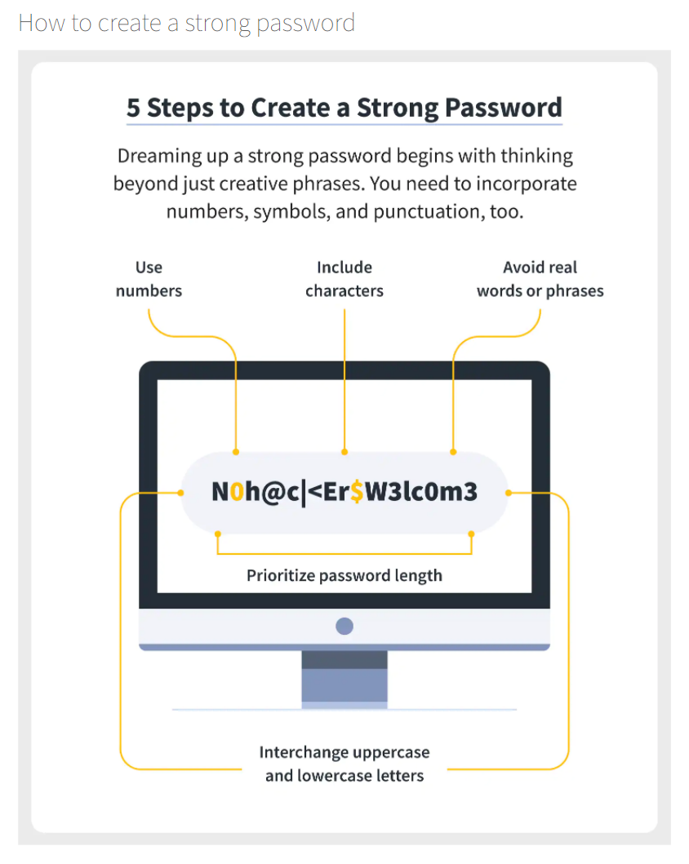
Notes:
What does the password say? “No Hackers welcome”

Slide 12
How Secure Is My Password? | Password Strength Checker (security.org)
Notes:
Ask someone for a password to use as an example.

Slide 13
Smart Phone Security

Slide 14
Stay safe while traveling!
Notes:
Be very wary of unsecured wireless! Theft can be physical as well as wirelessly.

Slide 15
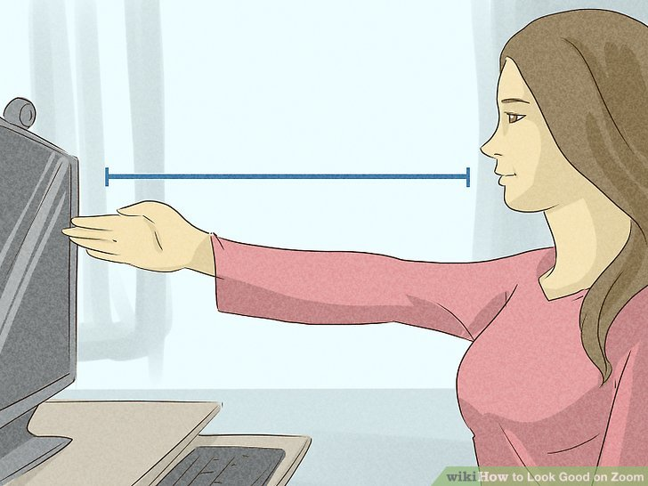
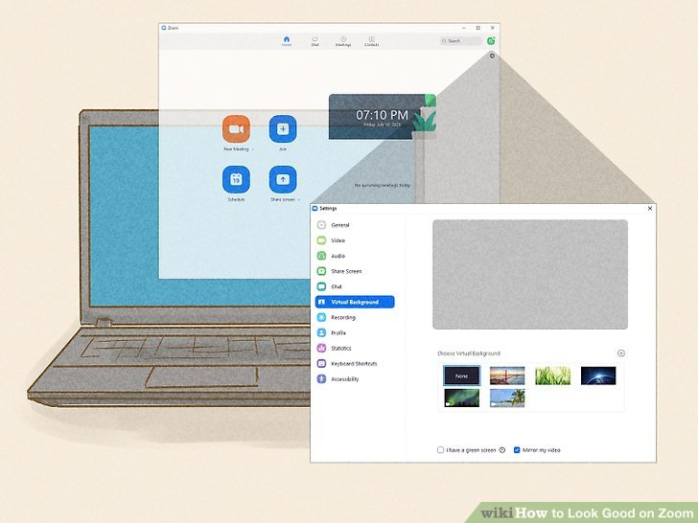
Zoom Hints
Camera Angle
Virtual Background

