Slide 1
“Buddy Checks”

Slide 2
“The Buddy Check”
What we will cover today:
What is it?
Why do we do it?
When do we do it?
Where do we do it?
How do we do it?

Slide 3
What is it?
It’s “Leadership 101”: a demonstration of our good nature to always care for our nation’s heroes and their communities
It is a CPR reportable event made formal by resolution to reach out to our fellow veterans and see how they are doing!

Slide 4
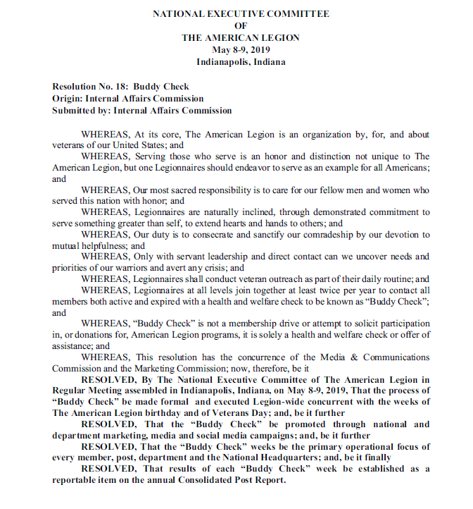

Slide 5
Why do we do it?
Because our nation expects us to
Because it’s the right thing to do
To compliment efforts by the DoD and VA
To check on our veteran’s well being (both physical and mental)

Slide 6
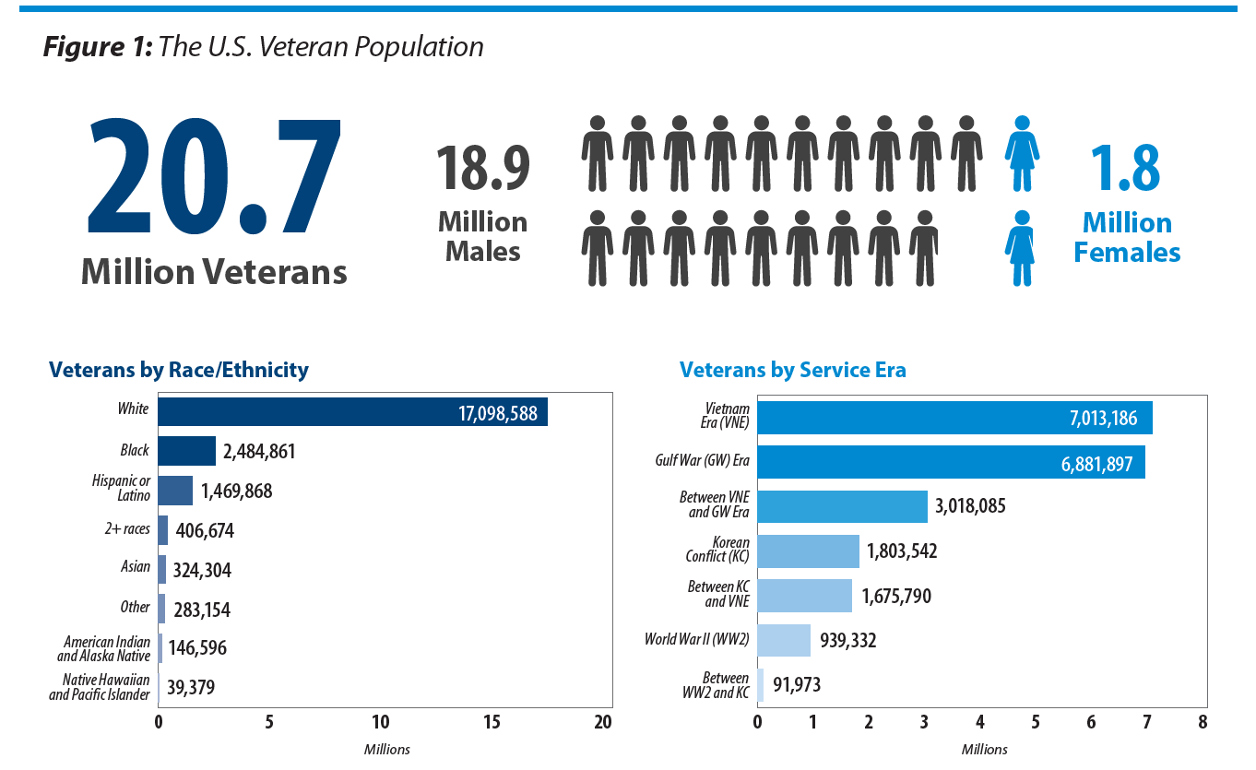
Whereas…

Slide 7
Whereas…
We genuinely care about others, or we would have never worn the uniform
Our oath to the Nation and to each other never expires
Veterans are proud, but fellow veterans can see vulnerabilities and needs of others
Veterans in crisis need a Legion behind them
We have an obligation to support efforts by the Department of Defense and the Department of Veterans Affairs to reduce veteran suicide, homelessness, addiction, etc.

Slide 8
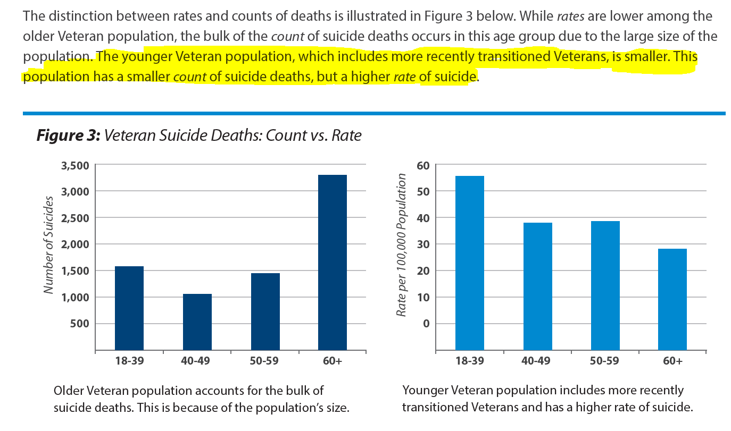

Slide 9
Whereas…
A Legionnaire’s daily and continuous mission is to take care of other veterans
By formalizing an informal process, we can quantify and qualify our efforts and improve processes in the future
Active and expired members have, at one point, made a commitment to The American Legion. Therefore, we made a commitment to them to look out for their health and welfare, and to assist within our means

Slide 10
Whereas…
The Buddy Check is not about renewing members, collecting dues, or asking for participation in events
It is truly veterans checking on veterans

Slide 11
Whereas…
This team effort has the support of all TAL Leadership

Slide 12
Resolved…
A formal process should illicit a deeper commitment and focus from participants
A twice-a-year formal process allows for robust marketing, collaboration, unity-of-effort, etc.
On, or around, The American Legion birthday and Veterans Day allows for annual planning, and the allocation of necessary resources to the event, during peak times of social support for our veteran population

Slide 13
Resolved…
A primary operational focus gives the Buddy Check credibility through Legion-wide support

Slide 14
Resolved…
The updated CPR asks for results of the Buddy Check to be documented so that further collaboration with the Department of Defense, The Department of Veterans Affairs, and others to address veteran needs can occur
Reporting may initiate future legislative initiatives that benefit our veteran population

Slide 15
When do we do it?
By resolution, at least twice a year around The American Legion Birthday (March) and Veterans Day (November)
As a regular part of our daily routine
When you think it is needed

Slide 16
Where do we do it?
In our communities
Wherever we interact with veterans
From your Departments/Districts/Posts and the comfort of your home as you see fit

Slide 17
How do we do it?
By asking the questions, extending the hands, and opening the hearts
Using the “Buddy Check” Toolkit provided by National or your Departments
Through phone, person-to-person interaction, social media, media, or any other way to reach out and let veterans know “we care”

Slide 18
Be The One?
Buddy Checks goes hand in hand with the Be The One campaign.
We need to take a proactive approach to reaching out to our veterans
You could be the one that makes a difference in a veteran’s life

Slide 19
What if …..?
(question and discussion time)
Most of the time the veteran will say they are fine. However, you need to be prepared to answer these types of responses!
What if the veteran can’t get things done around his house?
What if the veteran is having financial problems?
What if the veteran says is having a hard time and is thinking about suicide?
What if the veteran says, I just realized I have not renewed my membership?

Slide 20
Questions?

